Slide 1



Slide 2
About today…
React
Performance Optimization

Slide 4


Performance Optimization
Enhances user experience
Faster, smoother interactions keep users engaged
Reduces load times
Optimized applications load faster, improving user satisfaction
Improves app responsiveness
Quick updates and transitions make the app feel more responsive

Slide 5
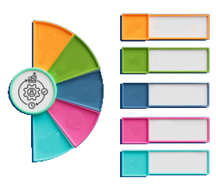
React Performance Principles
Minimize Re-Renders
Avoid unnecessary re-renders to save processing power
Efficient State Management
Properly manage state to prevent performance bottlenecks
Optimize Component Rendering
Ensure components render efficiently

Slide 6

Minimize Component Re-Renders
React.memo
Prevents unnecessary re-renders of functional components
Avoid Inline Functions/Objects
Inline props cause components to re-render every time
useCallback & useMemo
Optimize functions and calculations to avoid re-creation on every render

Slide 7
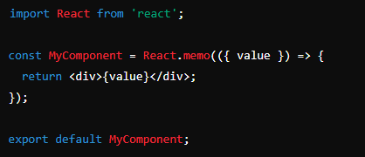

React.memo
Wrap a component with React.memo to avoid unnecessary re-renders when props don’t change

Slide 8
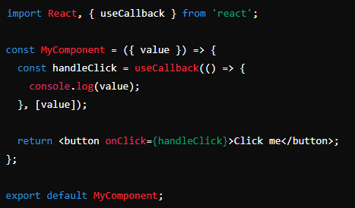

useCallback Hook
useCallback prevents re-creation of the handleClick function unless the dependencies change

Slide 9
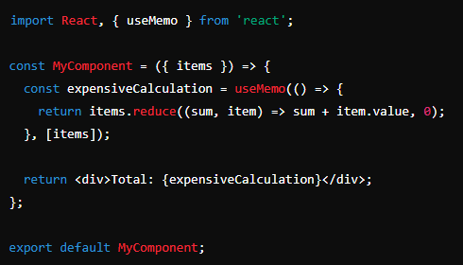

useMemo Hook
useMemo can be used to memoize an expensive calculation, avoiding recomputation on every render

Slide 10
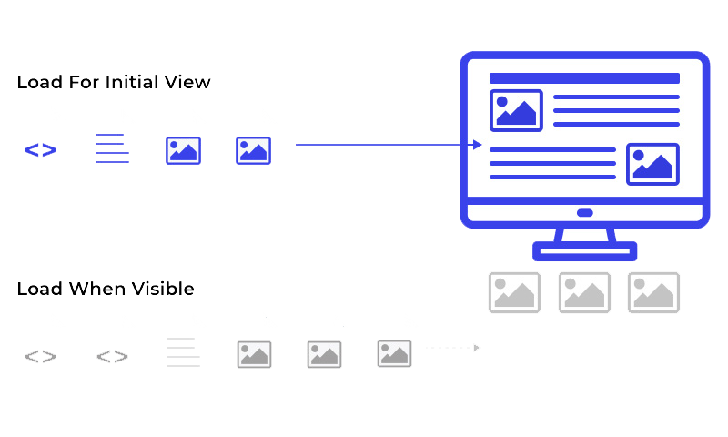
Lazy Loading
React.lazy and Suspense
Dynamically load components only when needed
Benefits
Reduces initial load time
Improves performance
Procedure
By splitting code into smaller chunks

Slide 11
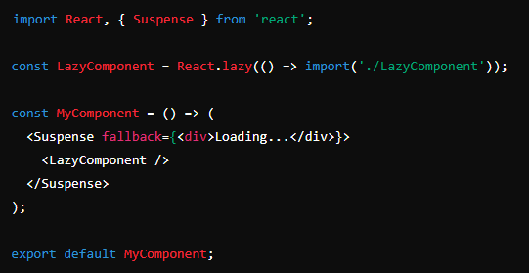
Lazy Loading (Example)
use React.lazy and Suspense to lazy load a component, improving initial load times

Slide 12
Virtualization
for Large Lists
Library Examples
Use react-window or react-virtualized to render only visible items in large lists
Benefits
Reduces the number of DOM nodes
Improves performance for large data sets

Slide 13
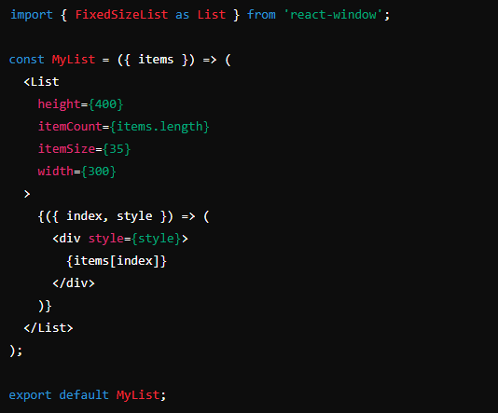
Virtualization (Example)
Use react-window to virtualize a list, rendering only the visible items & improving performance

Slide 14
State Management
Lift State Up
Only lift state when necessary to avoid prop drilling
Local State
Use local state for isolated components to avoid unnecessary re-renders
State Management Libraries
Consider libraries like Redux or Zustand for complex state management

Slide 15
Proper Use of Key Prop
Avoiding Reconciliation
Use a unique and stable key prop to avoid unnecessary re-renders
Best Practices
Ensure key is unique and does not change between renders

Slide 16
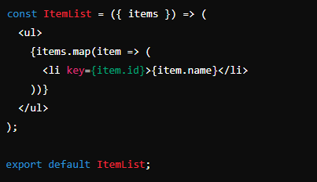
Key Prop (Example)
Use of the key prop to avoid unnecessary reconciliation and improve performance

Slide 17
Network Performance
Efficient Data Fetching
Use strategies like SWR or React Query for data fetching
Caching
Implement caching for repeated requests to reduce network load
Asset Optimization
Compress and optimize assets for faster load times

Slide 18
Image Optimization
Image Formats
Use appropriate image formats (e.g., WebP) for better performance
Responsive Images
Use srcset for responsive images
Lazy Loading
Use loading="lazy" attribute to defer offscreen images loading

Slide 19

What is the purpose of using React.memo?
Used to prevent unnecessary re-renders of functional components by memoizing the result and only re-rendering when the props change
What does the useCallback hook do?
Returns a memoized version of the callback function, which only changes if one of the dependencies has changed, preventing the function from being recreated on every render
What are the benefits of lazy loading components using React.lazy and Suspense?
Reduces the initial load time by splitting the code into smaller chunks and only loading components when they are needed

Slide 20


Slide 21

Task
Improve the performance of a simple React application by applying various optimization techniques

